Slide 1


Slide 2
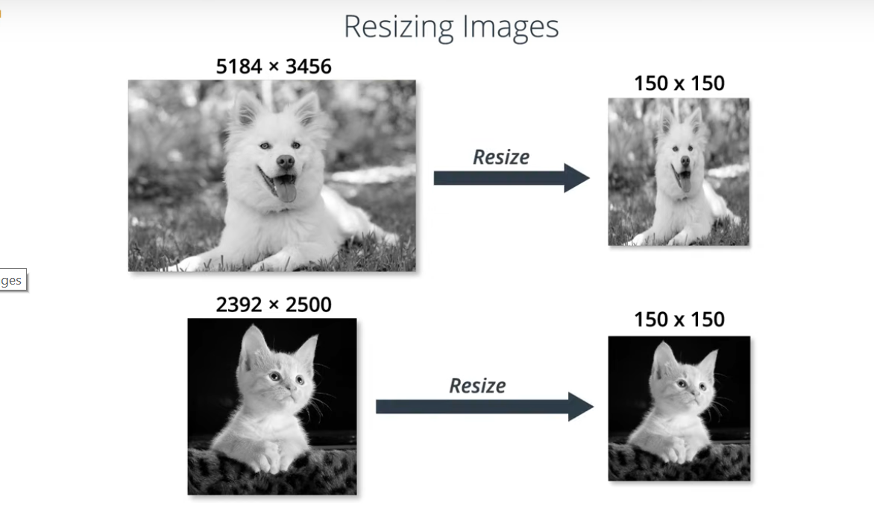

Slide 3
Min-Max Normalization
X - min
max - min

Slide 4
Min-Max Normalization
X - min
max - min
grayscale (1 channel) images
min value = 0 max value = 255

Slide 5
Min-Max Normalization
X - min
max - min
grayscale (1 channel) images
X - 0
X
255 - 0
255

Slide 6
Min-Max Normalization
X - min
max - min
grayscale (1 channel) images
X - 0
1
X
*
255 - 0
255

Slide 7
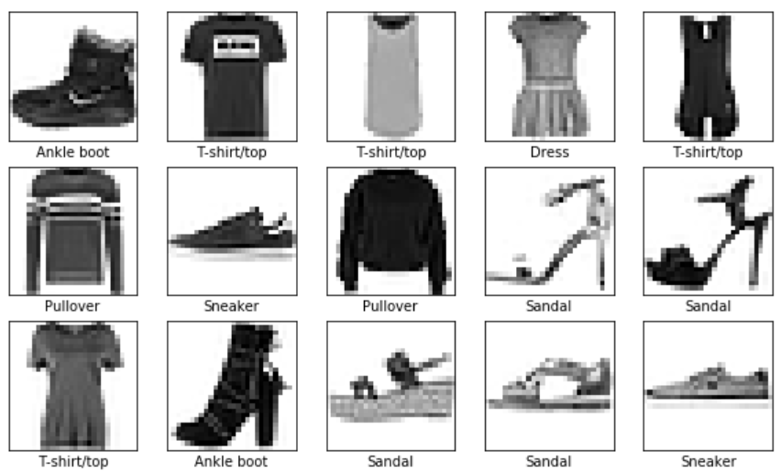

Slide 8
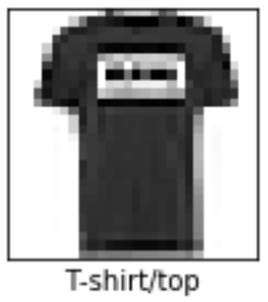
28 x 28
28 x 28 = 784

Slide 9
28 x 28
0 | 75 | 192 | 237 | 222 | 189 | 0
12 | 118 | 212 | 14 | 25 | 98 | 0
0 | 23 | 201 | 194 | 172 | 175 | 17
5 | 12 | 234 | 251 | 187 | 191 | 0
0 | 19 | 188 | 230 | 213 | 200 | 75
143 | 156 | 209 | 176 | 244 | 71 | 2
15 | 199 | 242 | 251 | 211 | 144 | 19
28 x 28 = 784

Slide 10
28 x 28 = 784
0 | 75 | 192 | 237 | 222 | 189 | 0
12 | 118 | 212 | 14 | 25 | 98 | 0
0 | 23 | 201 | 194 | 172 | 175 | 17
5 | 12 | 234 | 251 | 187 | 191 | 0
0 | 19 | 188 | 230 | 213 | 200 | 75
143 | 156 | 209 | 176 | 244 | 71 | 2
15 | 199 | 242 | 251 | 211 | 144 | 19
28 x 28 = 784
flatten
0 | 75 | 192 | 237 | 222 | 189 | 0 | …... | 15 | 199 | 242 | 251 | 211 | 144 | 19

Slide 11
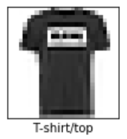

Slide 12
Flatten
0 | 75 | 192 | 237 | 222 | 189 | 0 | …... | 15 | 199 | 242 | 251 | 211 | 144 | 19

Slide 13
Flatten
0 | 75 | 192 | 237 | 222 | 189 | 0 | …... | 15 | 199 | 242 | 251 | 211 | 144 | 19
…

Slide 14
Flatten
0 | 75 | 192 | 237 | 222 | 189 | 0 | …... | 15 | 199 | 242 | 251 | 211 | 144 | 19
Dense
…

Slide 15
Flatten
0 | 75 | 192 | 237 | 222 | 189 | 0 | …... | 15 | 199 | 242 | 251 | 211 | 144 | 19
Dense
…

Slide 16
Flatten
0 | 75 | 192 | 237 | 222 | 189 | 0 | …... | 15 | 199 | 242 | 251 | 211 | 144 | 19
Dense
…
T-shirt
Trouser
Pullover
Dress
Coat
Sandal
Shirt
Sneaker
Bag
Boot

Slide 17
Flatten
0 | 75 | 192 | 237 | 222 | 189 | 0 | …... | 15 | 199 | 242 | 251 | 211 | 144 | 19
Dense
…
Dense
T-shirt
Trouser
Pullover
Dress
Coat
Sandal
Shirt
Sneaker
Bag
Boot

Slide 18
Flatten
0 | 75 | 192 | 237 | 222 | 189 | 0 | …... | 15 | 199 | 242 | 251 | 211 | 144 | 19
Dense
…
Dense
T-shirt
Trouser
Pullover
Dress
Coat
Sandal
Shirt
Sneaker
Bag
Boot

Slide 19
Flatten
0 | 75 | 192 | 237 | 222 | 189 | 0 | …... | 15 | 199 | 242 | 251 | 211 | 144 | 19
Dense
…
Dense
0
1
2
3
4
5
6
7
8
9
T-shirt
Trouser
Pullover
Dress
Coat
Sandal
Shirt
Sneaker
Bag
Boot

Slide 20
Flatten
0 | 75 | 192 | 237 | 222 | 189 | 0 | …... | 15 | 199 | 242 | 251 | 211 | 144 | 19
Dense
…
Sequential
Dense
0
1
2
3
4
5
6
7
8
9
T-shirt
Trouser
Pullover
Dress
Coat
Sandal
Shirt
Sneaker
Bag
Boot

Slide 21
Flatten
0 | 75 | 192 | 237 | 222 | 189 | 0 | …... | 15 | 199 | 242 | 251 | 211 | 144 | 19
Dense
…
Sequential
Dense
0
1
2
3
4
5
6
7
8
9
T-shirt
Trouser
Pullover
Dress
Coat
Sandal
Shirt
Sneaker
Bag
Boot
.674223 | .000007 | .004492 | .005600 | .000047 | .000000 | .315620 | .000000 | .000008 | .000000

Slide 22
Flatten
0 | 75 | 192 | 237 | 222 | 189 | 0 | …... | 15 | 199 | 242 | 251 | 211 | 144 | 19
Input
Dense
…
Sequential
Dense
0
1
2
3
4
5
6
7
8
9
T-shirt
Trouser
Pullover
Dress
Coat
Sandal
Shirt
Sneaker
Bag
Boot
.674223 | .000007 | .004492 | .005600 | .000047 | .000000 | .315620 | .000000 | .000008 | .000000
Output

Slide 23
Flatten
0 | 75 | 192 | 237 | 222 | 189 | 0 | …... | 15 | 199 | 242 | 251 | 211 | 144 | 19
Input
Dense
…
Sequential
Dense
0
1
2
3
4
5
6
7
8
9
T-shirt
Trouser
Pullover
Dress
Coat
Sandal
Shirt
Sneaker
Bag
Boot
.674223 | .000007 | .004492 | .005600 | .000047 | .000000 | .315620 | .000000 | .000008 | .000000
Output

Slide 24
Flatten
0 | 75 | 192 | 237 | 222 | 189 | 0 | …... | 15 | 199 | 242 | 251 | 211 | 144 | 19
Input
Dense
…
Sequential
Dense
0
1
2
3
4
5
6
7
8
9
T-shirt
Trouser
Pullover
Dress
Coat
Sandal
Shirt
Sneaker
Bag
Boot
.674223 | .000007 | .004492 | .005600 | .000047 | .000000 | .315620 | .000000 | .000008 | .000000
Output

Slide 25
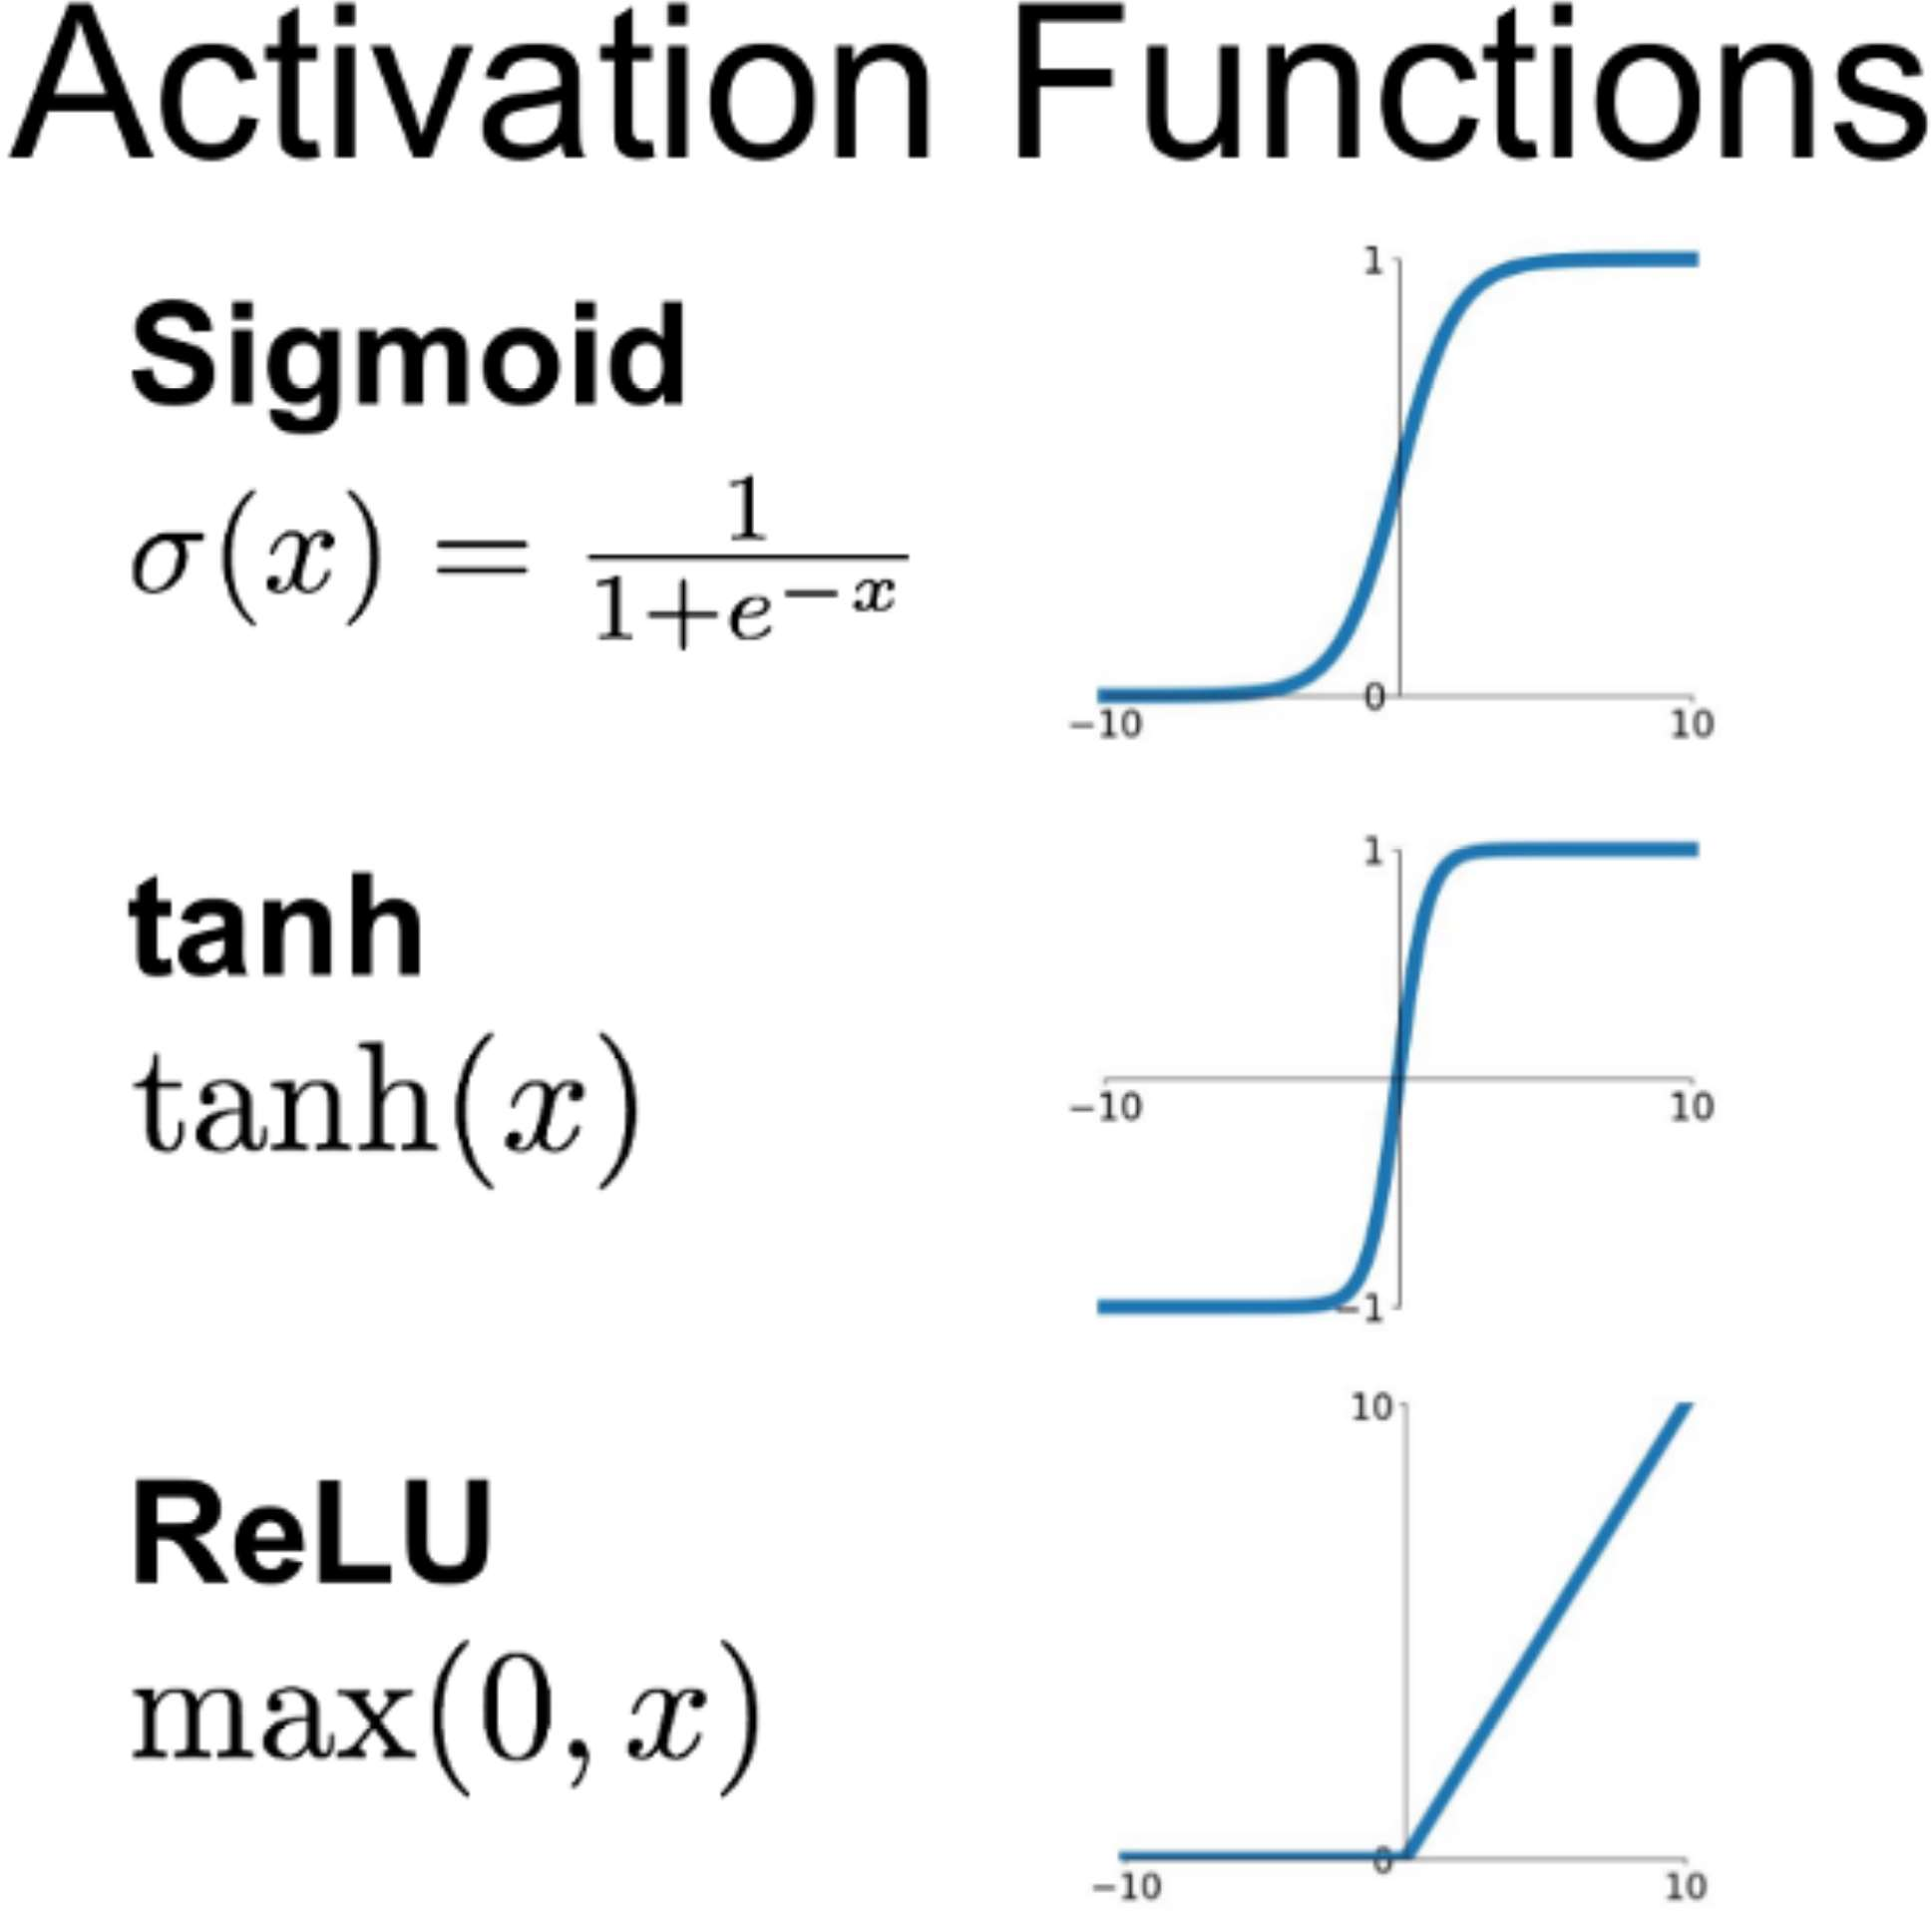

Slide 26
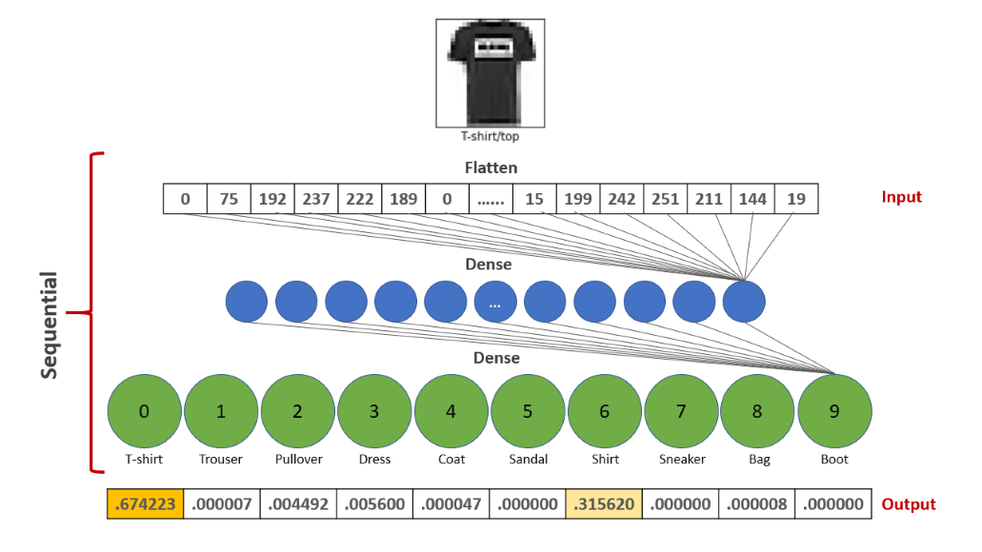


Slide 27
TensorFlow
model = keras.Sequential([

Slide 28
TensorFlow
model = keras.Sequential([
keras.layers.Flatten(input_shape=(28, 28)),

Slide 29
TensorFlow
model = keras.Sequential([
keras.layers.Flatten(input_shape=(28, 28)),
keras.layers.Dense(128, activation=‘relu’),

Slide 30
TensorFlow
model = keras.Sequential([
keras.layers.Flatten(input_shape=(28, 28)),
keras.layers.Dense(128, activation=‘relu’),
keras.layers.Dense(10, activation=‘softmax’)
])

Slide 31
Learn from the data
model.fit(train_images, train_labels, epochs=5)

Slide 32
Learn from the data
model.fit(train_images, train_labels, epochs=5)
Make predictions on new data
model.predict(test_images)

Slide 33
Learn from the data
model.fit(train_images, train_labels, epochs=5)
Make predictions on new data
model.predict(test_images)
Display accuracy of model’s predictions
model.evaluate(test_images, test_labels)

Slide 35
colab.research.google.com/

Slide 37
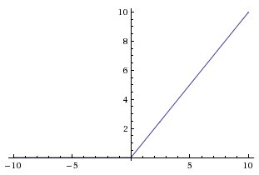
ReLU
f(x) = max(0, x)

